Slide 1
EES203: Geochemistry
Instructor: Anoop Ambili
Email id: anoop@iisermohali.ac.in

Slide 2
Carbon isotopes
Notes:
Change date

Slide 3
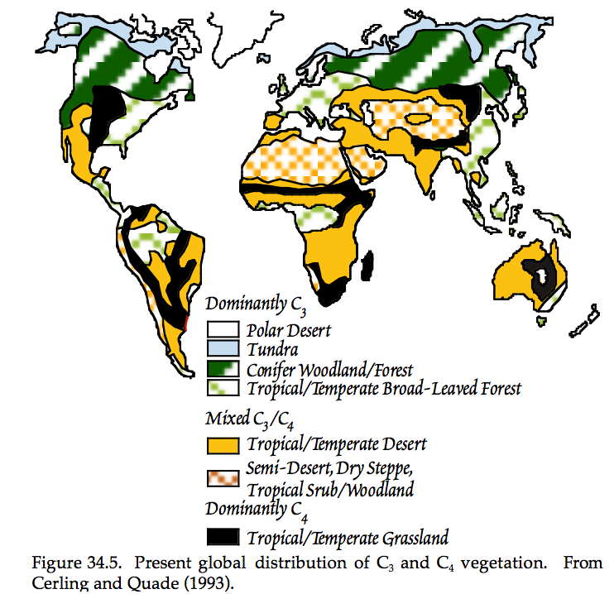

Slide 4
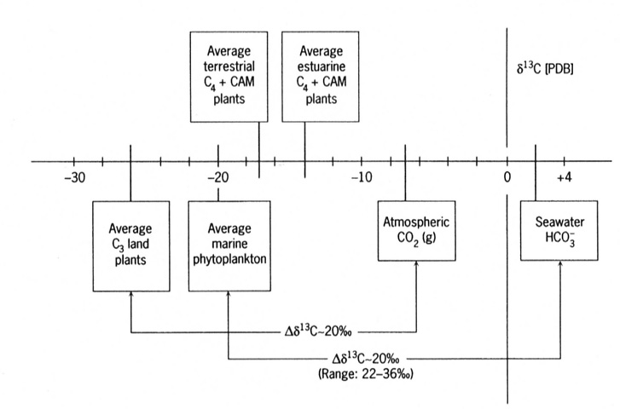
Case study: δ¹³C of bulk organic matter to determine source
C₄ = grasses Crassulacean acid metabolism, also known as CAM photosynthesis, is a carbon fixation pathway
that evolved in some plants as an adaptation to arid conditions

Slide 5
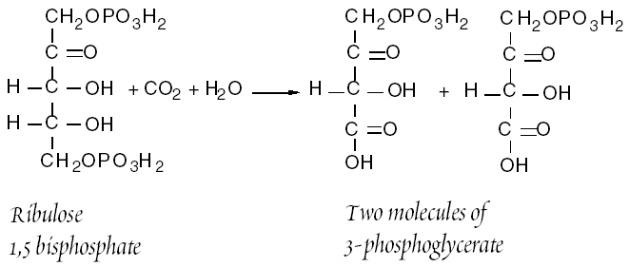
Photosynthesis
Terrestrial photosynthesis - theoretical calculations predict a 4.4‰
kinetic fractionation for CO₂(g) moving from air through stomata to site of
photosynthesis
C3 Pathway
enzyme-mediated
(RUBISCO)
-RUBISCO fixes 1 O₂
for every 5 CO₂
“Calvin” cycle
90% of all plants
20-30‰ fractionation
Notes:
Effective at grabbing CO2, not just kinetics

Slide 6
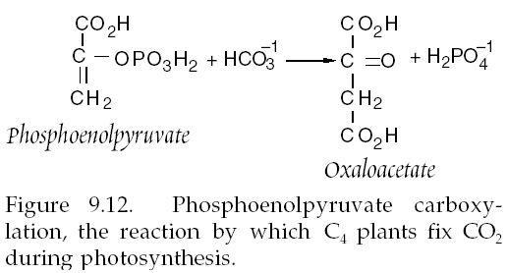
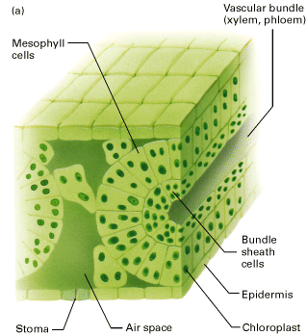
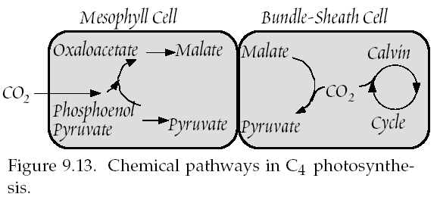
C4 Pathway
desert plants, some
tropical species
enzyme-mediated
(PEP)
“Hatch-Slack” cycle
10% of all plants
13‰ fractionation
NOTE: C4 plants still execute “Calvin”
cycle, but CO2 grabbing and actual
carbon fixation happening in different cells
Notes:
Separated in space (grab effective)

Slide 7
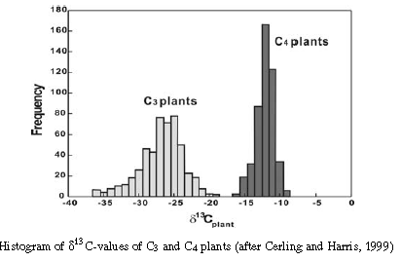
C₃ vs C₄ plants

Slide 8
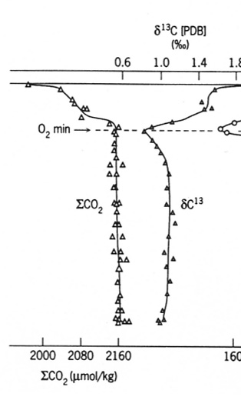
Case study: profiles of δ¹³C to estimate primary productivity
The profiles of δ¹³C can be used to estimate primary productivity
More photosynthesis in surface results in a heavier δ¹³C, resulting in a more positive δ¹³C in surface DIC
North Atlantic data

Slide 9
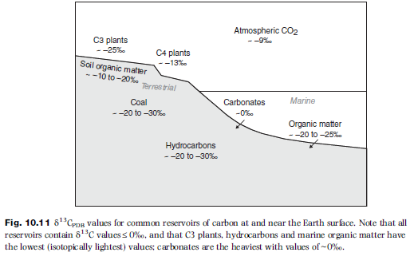
Carbon Isotope values
Source: Chapter 10 (Environmental and Low Temperature Geochemistry; Ryan, 2014)

Slide 10
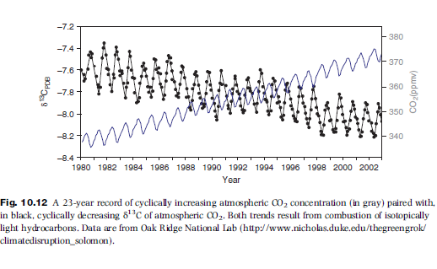
Carbon Isotope values
Source: Chapter 10 (Environmental and Low Temperature Geochemistry; Ryan, 2014)

Slide 11
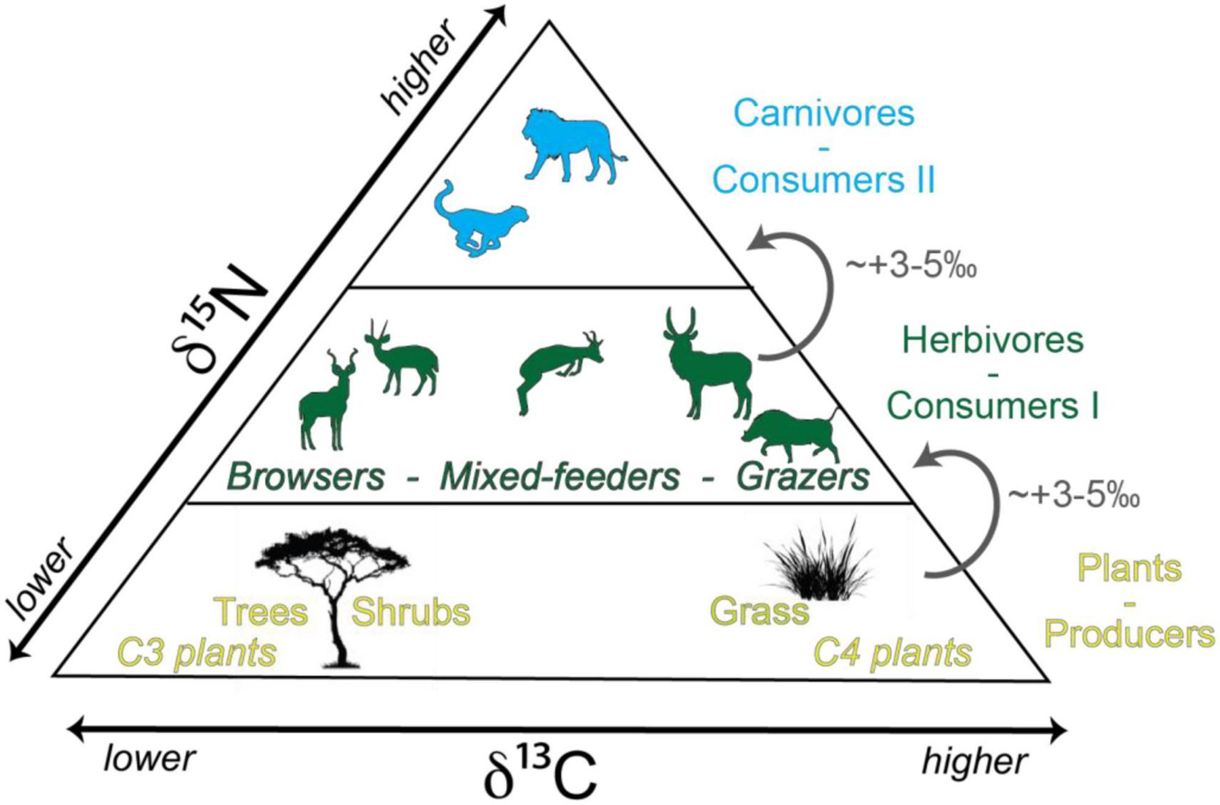
Information on “paleodiet”

Slide 12
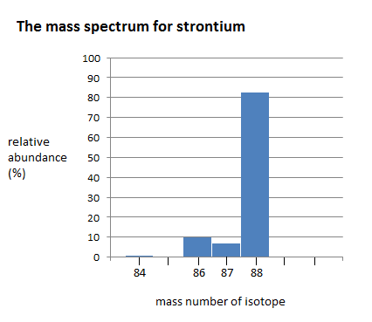
Isotopes of Strontium
The alkali earth metal strontium has four stable naturally occurring isotopes:
^{~84}Sr (0.56%)
^{~ 86}Sr (9.86%)
^{~87}Sr (7.0%) and
^{~88}Sr (82.58%)
Relative abundance (%)
Strontium isotopes
McArthur et al., 2012

Slide 13
Evolution of Strontium Isotope ratios
Fractionation of Rb/Sr between
upper mantle and continental crust
Evolution of ⁸⁷Sr / ⁸⁶Sr ratio from bulk earth ration since fractionation
Elderfield, 1985

Slide 14
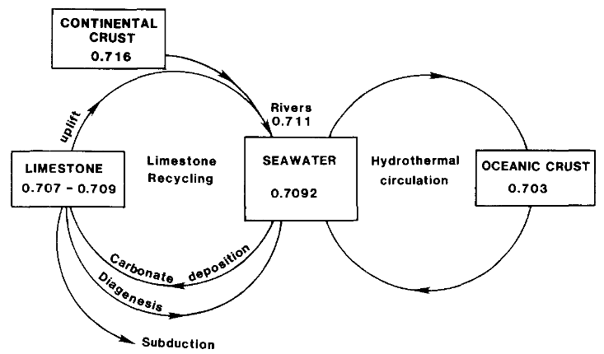
Geochemical cycle of strontium
Elderfield, 1985

Slide 15
Estimated values of Strontium Isotopes
Primordial ⁸⁷Sr/⁸⁶Sr ratio ~0.699
Strontium- depleted ocean basalts ~ 0.703
Strontium- enriched continental rocks ~0.701 to 0.740
Modern seawater has ⁸⁷Sr/⁸⁶Sr ~0.709

Slide 16
Applicability of Strontium for chemostratigraphy
Sr Ocean Residence Time (⁸⁷Sr): ~4 x 10⁶ yrs
Ocean Mixing Time: ~10³ yrs
Well-mixed with Sr at any point of time.
Negligible/near about absent effects of isotope fractionation
Absence of ⁸⁷Rb in carbonate phase

Slide 17
Strontium Isotope Stratigraphy
Strontium isotope stratigraphy relies on recognised variations in the ⁸⁷Sr/⁸⁶Sr ratio of seawater over time.
Using the more conventional biostratigraphic correlation techniques we can create high resolution stratigraphy of marine sedimentary sections.
⁸⁷Sr/⁸⁶Sr in a mineral precipitated from seawater, such as biogenic carbonate, micrite or a marine-derived evaporite, can be used to determine depositional age by comparison to a empirical calibrated curve of ⁸⁷Sr/⁸⁶Sr against time.

Slide 18
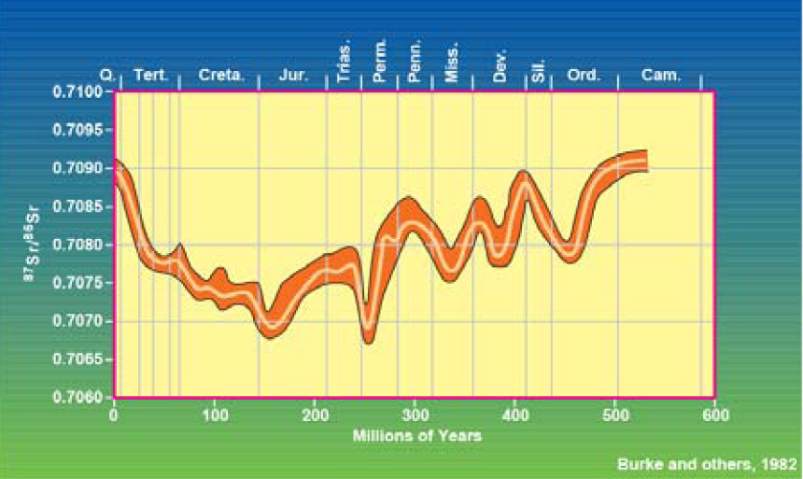
Change in Isotope ratio throughout Phanerozoic time
Veizer , 1989

Slide 19
Lowess curve and its use in Isotope Stratigraphy
LOWESS fit for the period 0-610 Ma with 95% confidence bounds. McArthur et al., 2001

Slide 20
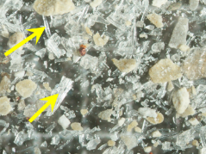
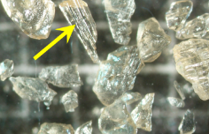
Ideal Materials for SIS
Samples must have high potential for retaining their original marine strontium isotope ratios.
High registance to Diagenesis.
Shells of Mg Calcitic composition yields narrow uncertainty bands.
Secondary Alteration are found and diagnosed beforehand to avoid mistaken results.
Foraminiferal, Belemnite Guards and Bivalve Shells etc.
Bivalve shell
Belemnite

Slide 21
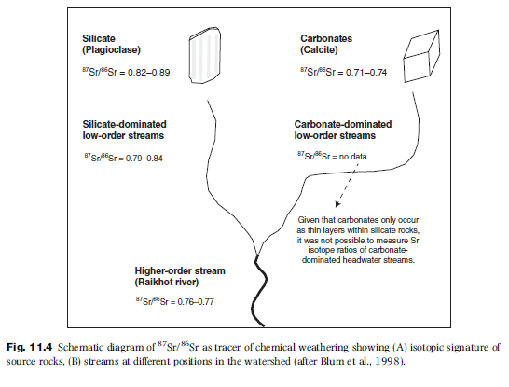
Applicability of Strontium for Weathering

Slide 22
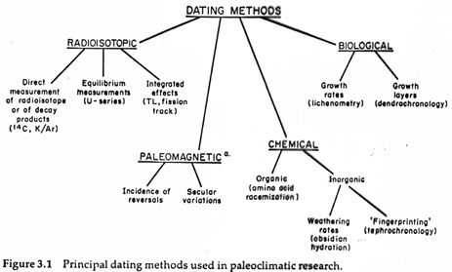

Slide 23
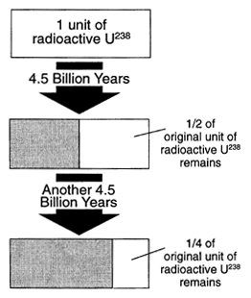
Principles of Radiometric Dating
C. How it works (radioactive decay)
1. Decay rates of radioactive atoms are constant
2. Unaffected by temperature, pressure, water, etc.
3. Half Life: time it takes for half the atoms of the parent isotope to decay, ranges from tens of billions of years to thousandths of a second.
Percentage of parent atoms that decay in each half life is the same (50%)
The actual number of atoms that decay with each passing half-life continually decreases
Increase in daughter = decrease in parent

Slide 24
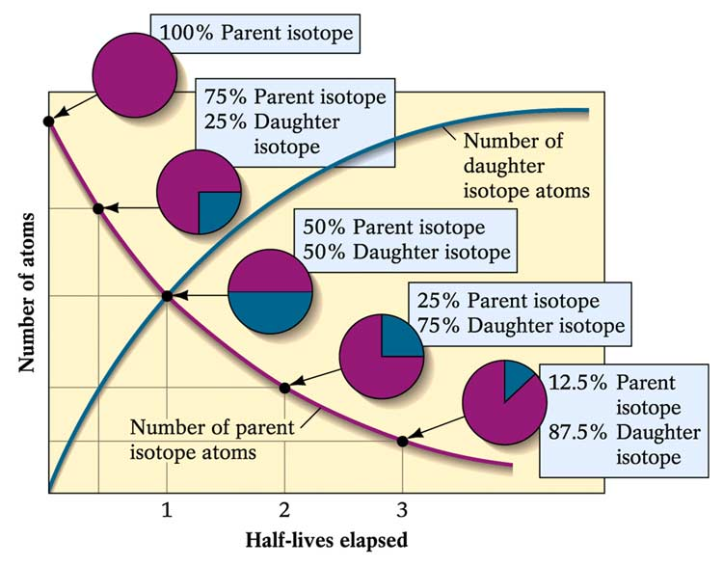
I. Principles of Numerical Dating
How it works (radioactive decay)
4. When mineral crystallizes (e.g., zircon mineral)
a. some amount of radioactive parent may get incorporated into the mineral structure
b. but daughter is different element and doesn’t “fit” in the structure (or inert and won’t combine), so at the time of formation there is 100% parent and 0% daughter

Slide 25
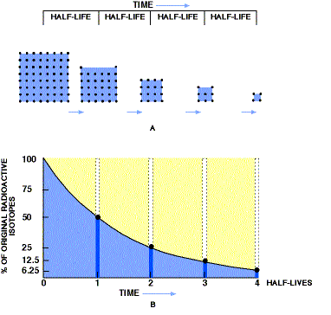
Principles of Numerical Dating

Slide 26
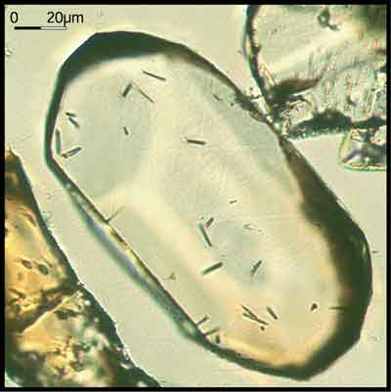
Principles of Numerical Dating
Radioactive isotopes are incorporated in minerals and rocks in a variety of ways.
As minerals crystallize from magma, radioactive isotopes are included in mineral crystal structure.
At the time of crystallization, only parent isotopes are included in the mineral.
Radioactive parent isotopes then begin to decay producing daughter isotopes.

Slide 27
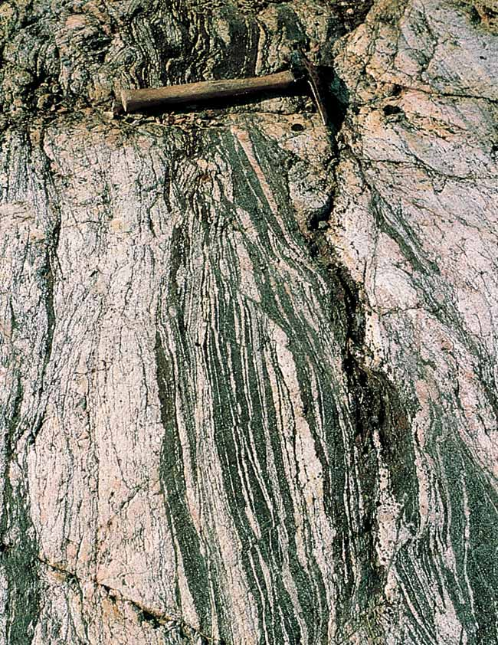
I. Principles of Numerical Dating
D. Dating Rocks
Igneous rocks – the best! Dates when the minerals formed
2. Metamorphic: during metamorphism ions can migrate, so dating tells us when metamorphism ended.
3. Sedimentary rocks: more errors because it dates the age of the individual pieces, gives maximum age

Slide 28
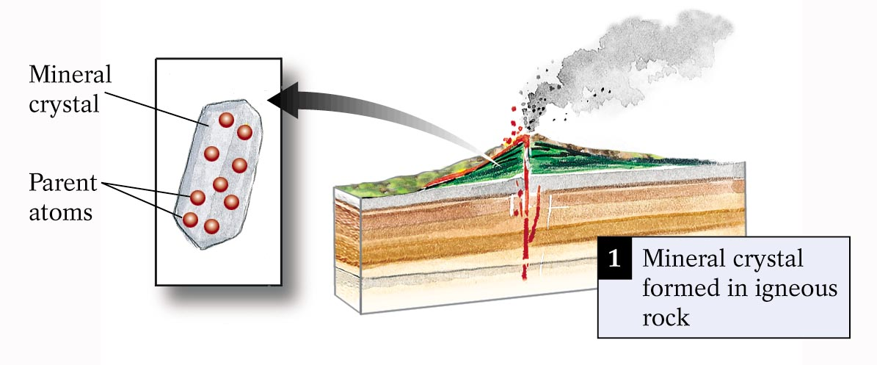
Principles of Numerical Dating

Slide 29
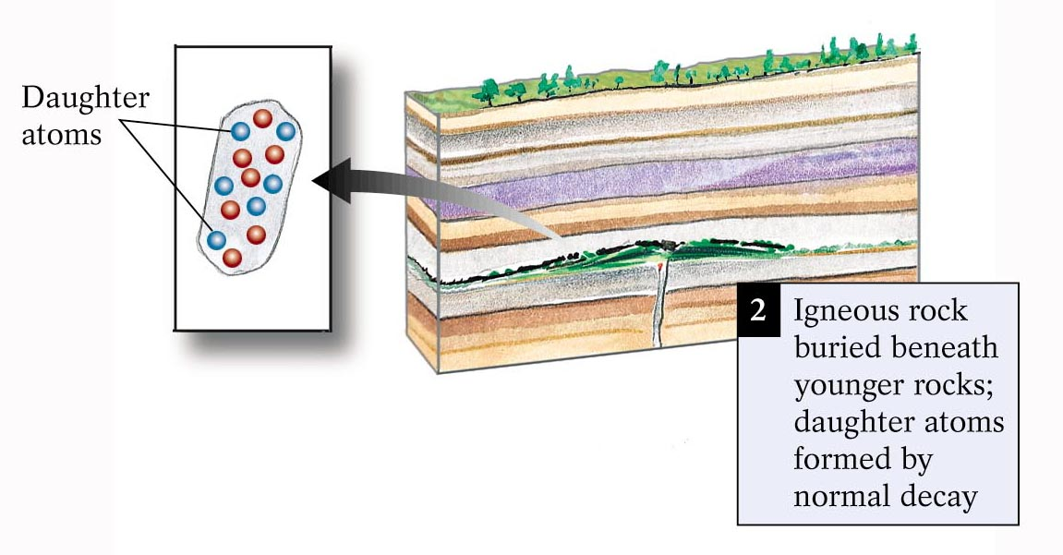
I. Principles of Numerical Dating

Slide 30
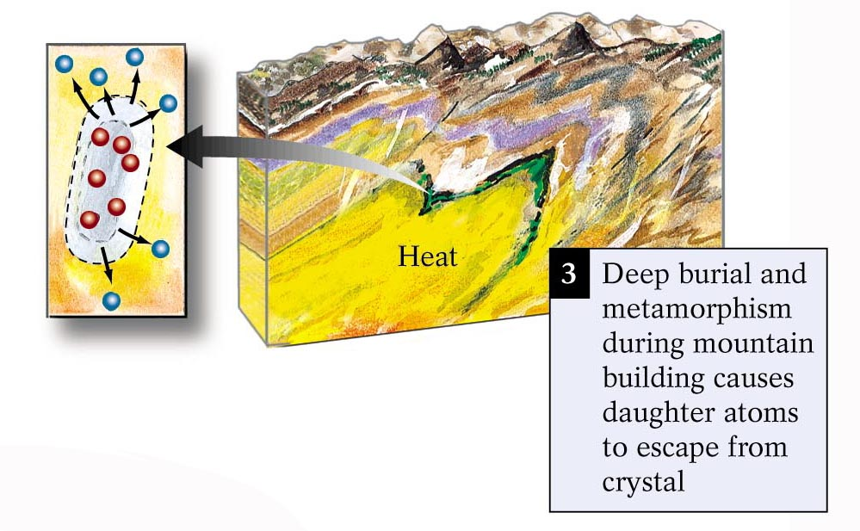
I. Principles of Numerical Dating

Slide 31
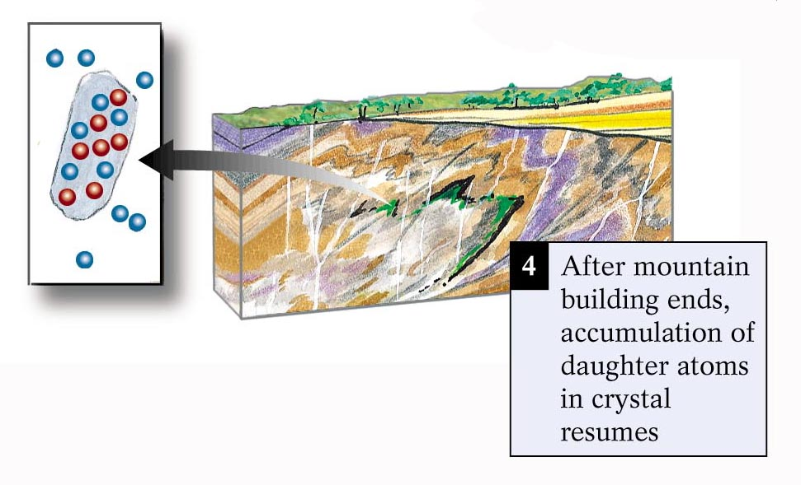

Slide 32
Principles of Numerical Dating
Sources of Error
Groundwater can bring in new ions and carry old ions away
Sample fractured and weathered rock, makes the age of the rock too young
Very young rocks: not enough time to accumulate daughter isotopes to be measured accurately
So we date many different samples and make sure the ages agree
We date using different dating methods to make sure they agree

Slide 33
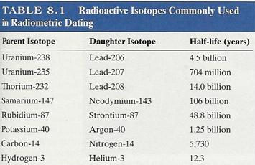
Types of Isotope Dating

Slide 34
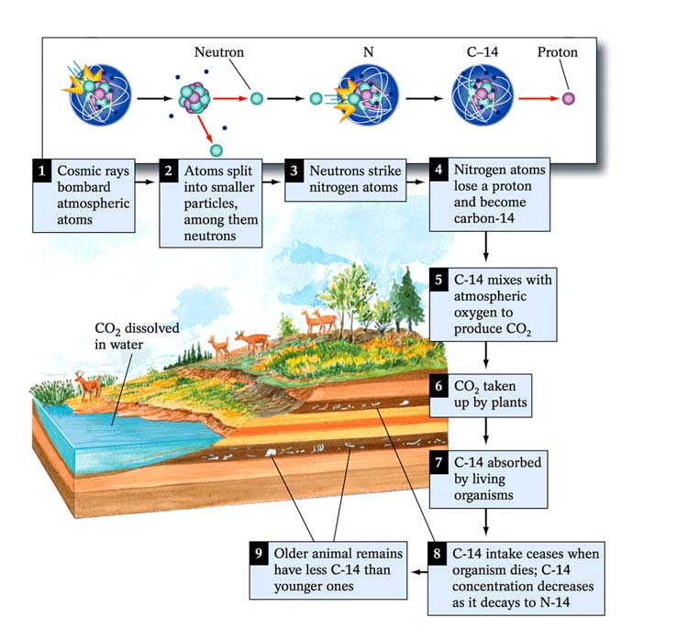
Radiocarbon dating
Naturally occurring isotope carbon-14 (¹⁴C) to determine the age of carbonaceous materials up to about 50,000 years
Raw (uncalibrated) radiocarbon ages are usually reported in radiocarbon years "Before Present" (BP)

